Slide 1
Modeling the Effects of Auditory Neuropathy on the Auditory Brainstem Response
Graham Voysey
Binaural Hearing Lab
M.S. Thesis Defense
18 August, 2016

Slide 2
Motivation
So I can ask this question two ways, but let me ask it this way: What should we leave in? What's the bare minimum we should leave in as we try to understand what's important about the function of the cochlea?
-- David Mountain, 2014
→ And how can you tell? ←

Slide 3
Outline
Motivation
Background
Modeling the Cochlea
Modeling the Auditory Nerve
Modeling the Brainstem and Midbrain
Large-Scale Simulation Results
Further Directions

Slide 4
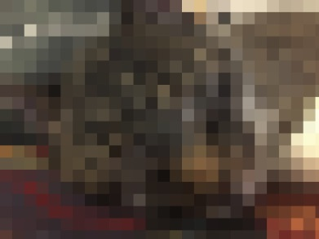
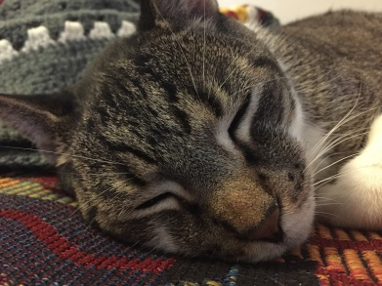
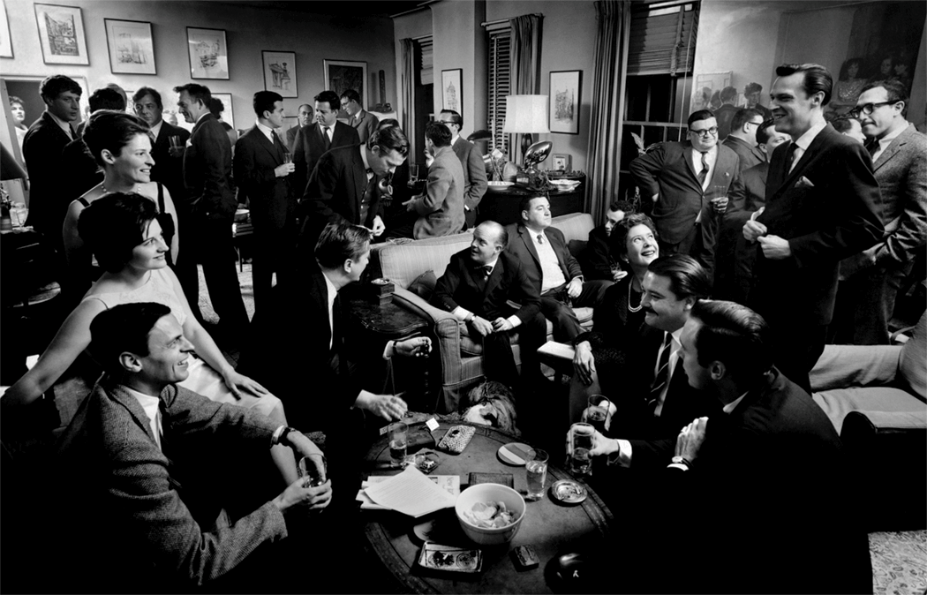
Motivation: Big Picture
Hidden Hearing Loss is not diagnosed by standard audiometric threshold testing
Audiometry tests for detection, not discrimination.
NHT performance differences
Mechanism(s) of HHL currently under debate;
No objective diagnostics for loss of discrimination currently exist

Slide 5
Potential Causes of HHL
Central Processing Disorder: A polite way of saying “We have no idea. Your ear seems fine; maybe it’s all in your head”
Sometimes, deficits or disorders actually are central (e.g., tinnitus)
Auditory Neuropathy (Cochlear Synaptopathy):
What would peripheral damage that does not affect thresholds or middle ear mechanics, but does affect the fidelity of the transmission of sound from the ear to higher areas look like?
Auditory Nerve is a good place to start looking.
Some Precortical Processing Deficit
Informational deficit.

Slide 6
The Big Goals
Better understand the mechanisms of HHL
Develop an objective test for HHL.
(These goals may be unrelated to each other …)

Slide 7
Work to Date
Based on experimental work to design a test.
Seeks to understand what’s important about different parts of the auditory system
Not interested in a model of everything.
Plausible implication of different mechanism
A way to ask “experimentable” questions.
Also a flexible tool to easily use models to answer other questions.

Slide 8
Auditory Brainstem Response

Slide 9
Aims
Model Human Experiments
Explore The Effects of Changing Models
Relate Modeling to New Experiments

Slide 10
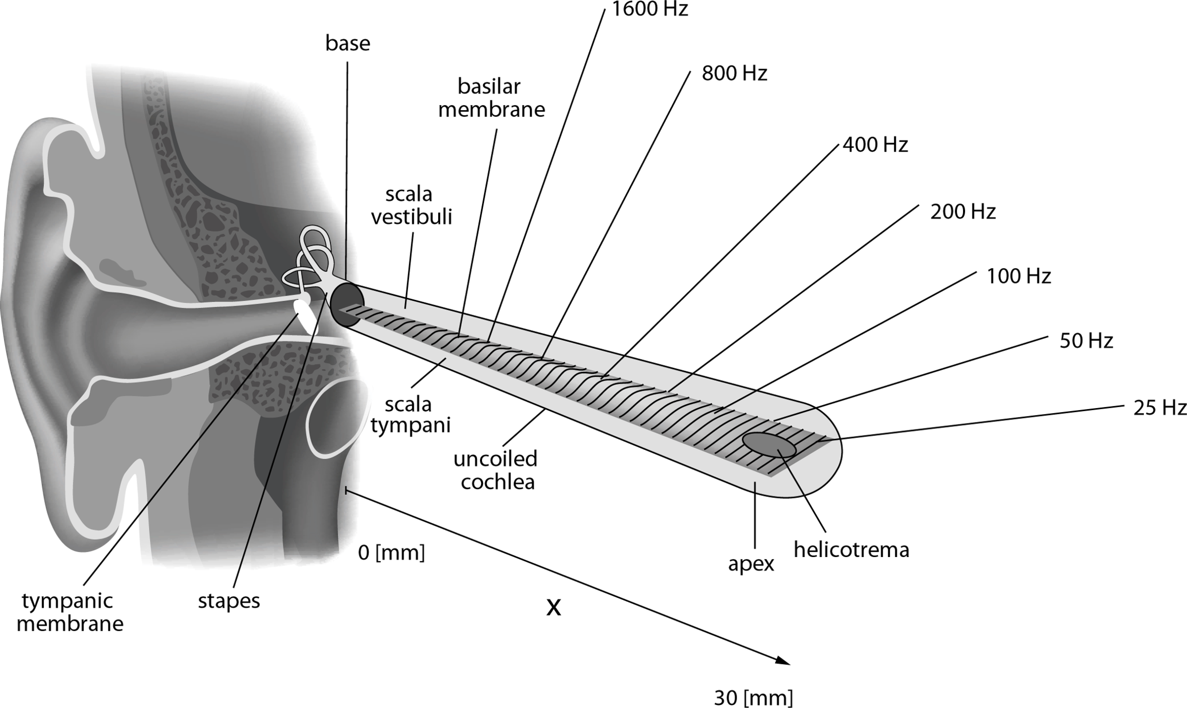

Slide 11
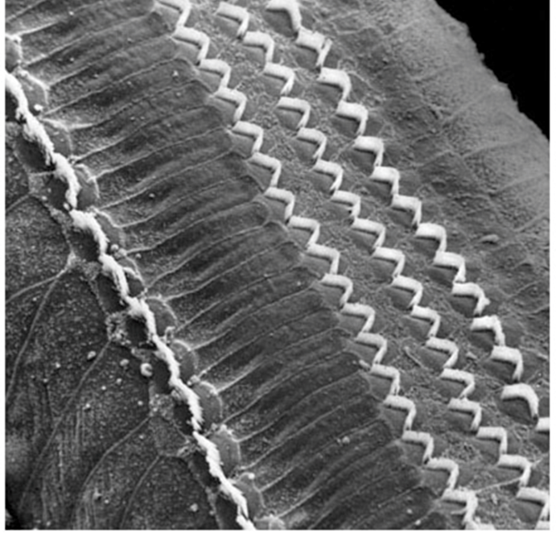
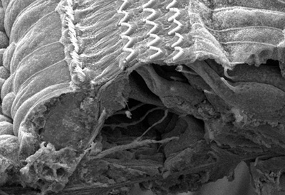
Mechanics of Hearing (Review)

Slide 12
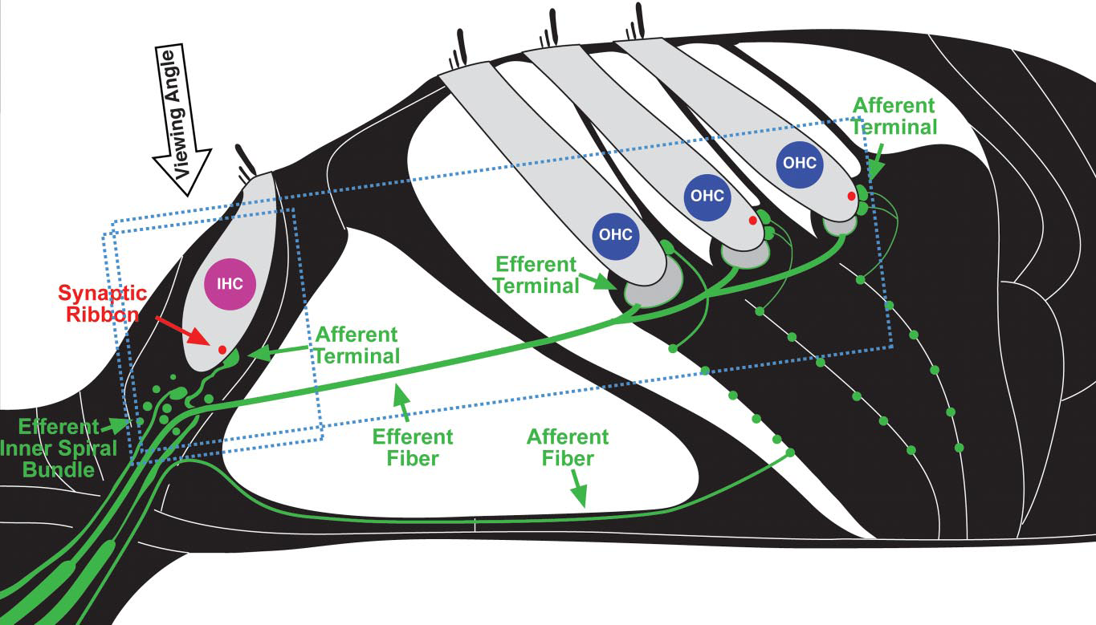
Mechanics of Hearing (Review)
Kujawa & Liberman (09), Hudspeth (14)
Hudspeth, 2014
Notes:
Basilar Membrane motion → Spikes on AN fibers
Beginning of tonotopic organization
Many fibers per IHC
Fibers have two (or three) categories according to their spontaneous firing rate

Slide 13
Auditory Nerve Fiber Rates

Slide 15
Auditory Nerve Distributions

Slide 16
Deafferentiation is Selective

Slide 17
Deafferentiation in Noise or Time

Slide 18
Auditory Nerve Projections

Slide 19
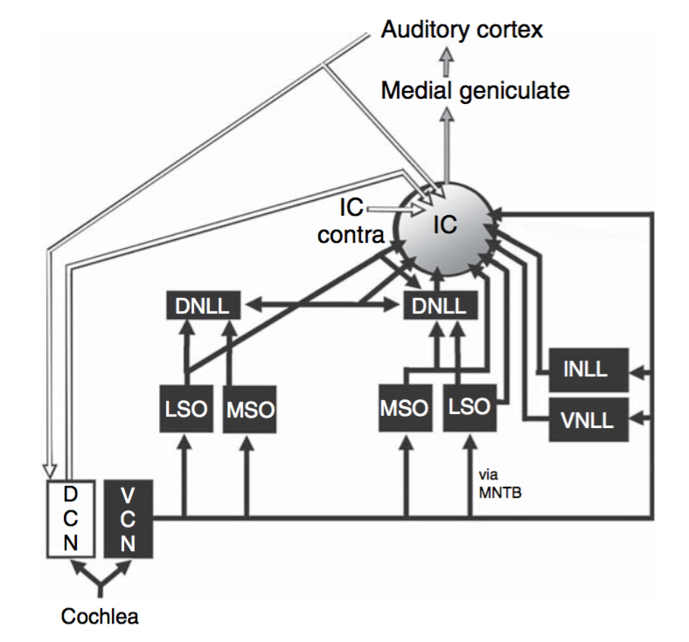
Mechanics of Hearing (Review)
Kaas and Hackett, 2008
Notes:
After that, it gets … complicated.

Slide 20
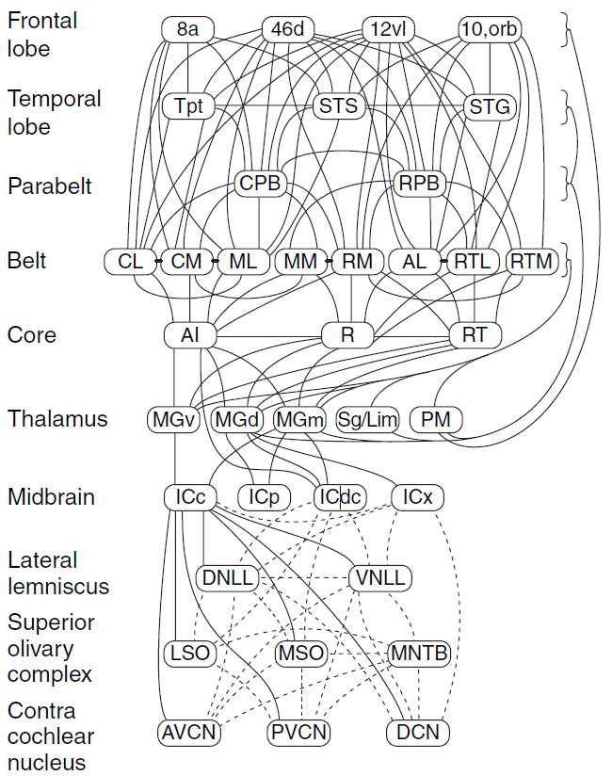
Mechanics of Hearing (Review)

Slide 22
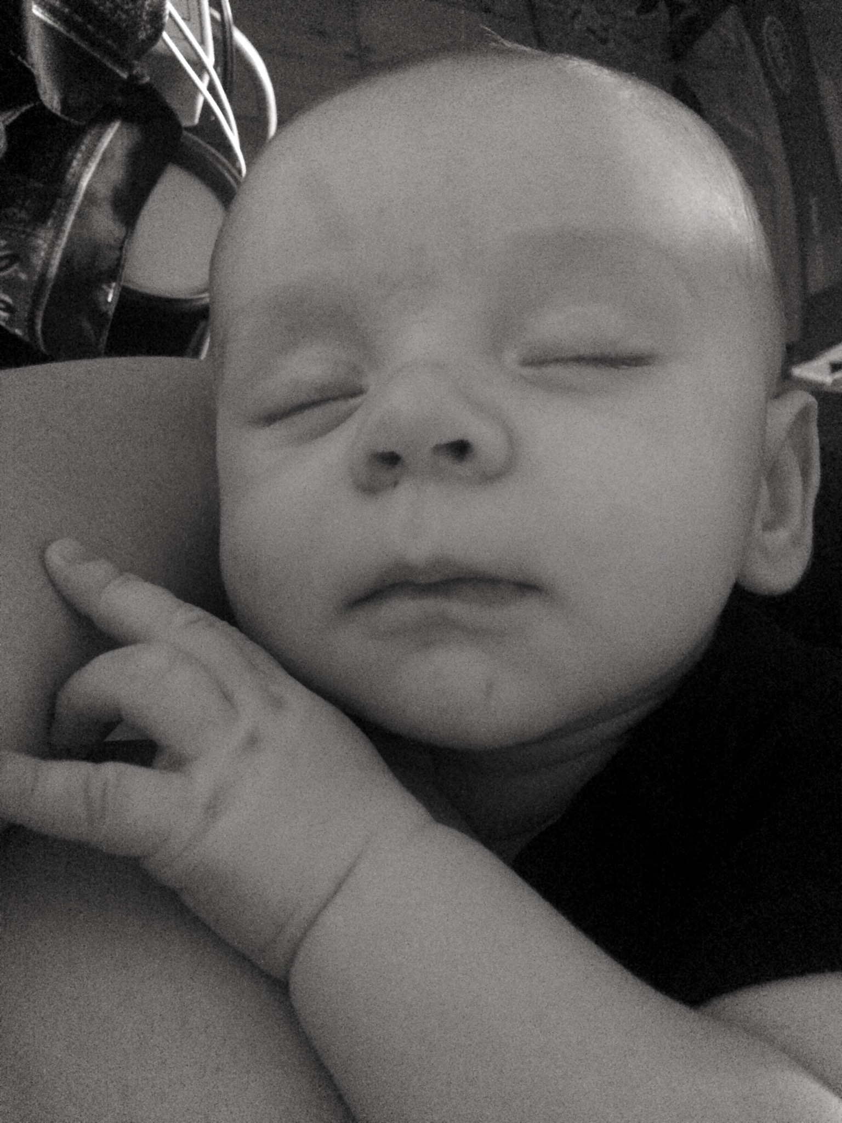
Acknowledgements
Committee
Steve Colburn
Barb Shinn-Cunningham
Allyn Hubbard
Heidi Nakajima
BU Alumni and Visitors
Sarah Verhulst
Laurel Carney
Gerard Encina-Llamas
Daryl Kelvasa
Auditory Biophysics Lab
Dave Mountain
Dave Anderson
Aleks Zosuls
Andy Brughera
Personal
My family!
Auditory Neuroscience Lab
Goldbarg Mehraei
Le Wang

Slide 23


Slide 24
